Slide 1

Practicing international criminal law
February 2022
Stetson University College of Law Presentation
Law Office of Robert Eckard & Associates, P.A.
Robert D. Eckard, Esq.
Florida Board Certified Business Litigation Attorney
Palm Harbor, Florida
Telephone: (727)772-1941
E-Mail: Robert@RobertEckardlaw.com
WWW.RobertEckardLaw.com

Slide 2
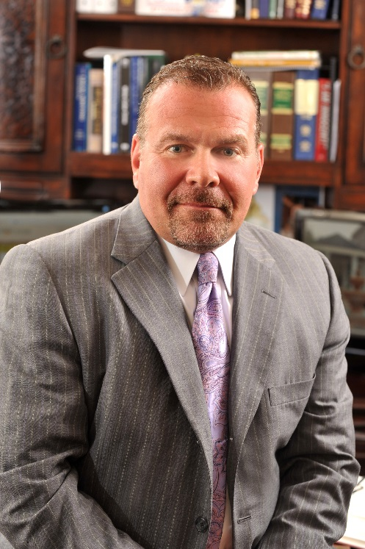
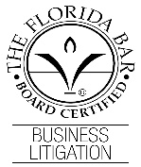
About the Author-Robert D. Eckard
Rob is a native of New York and has been living in Florida for 30 years. He is the managing partner in a litigation firm he established in 2000 after leaving the State Attorneys’ Office, 6th Judicial Circuit, Florida where he prosecuted both felony and misdemeanor criminal cases. Rob is Board Certified in Business Litigation by the Florida Bar (less than 300 lawyers in the State of Florida are Board Certified in Business Litigation). Rob’s background, training and experience in both business litigation, criminal defense and as a former state prosecutor make him uniquely qualified in handling business crimes. Rob has been elected annually by his peers as one of Florida’s Legal Elite™ in Commercial Litigation, and Super Lawyers™. He is also ranked 10/10 on AVVO.com. Rob is a graduate of Stetson University College of Law (honors), has an LL.M. degree in International Law. He has been admitted to the Florida Bar, Washington, D.C. Bar, the United States District Court for the Middle, Northern and Southern Districts of Florida, the 11th Circuit Court of Appeals, the United States Court of International Trade, the United States Supreme Court, and the United States Tax Court. Rob is a former Trustee for the Clearwater Bar Foundation and is a member of the Florida Bar Grievance Committee. He is a regular instructor at Stetson University College of Law. Rob has also been admitted to practice law pro hac vice in the State of California, the Eastern District of New York Federal Court (Brooklyn), The Southern District of New York (Manhattan), New York State Supreme Court (Manhattan Division), Eastern District of Pennsylvania Federal Court (Philadelphia), The District of Massachusetts (Boston), the Western District of Kentucky (Louisville) as well as others. Rob has handled many parallel cases involving the United States Department of Justice and the United States Securities and Exchange Commission.
Rob has handled international criminal cases including- International Narco-Trafficking, Visa Fraud, Murder and Conspiracy to Murder United States National as well as other offenses.

Slide 3
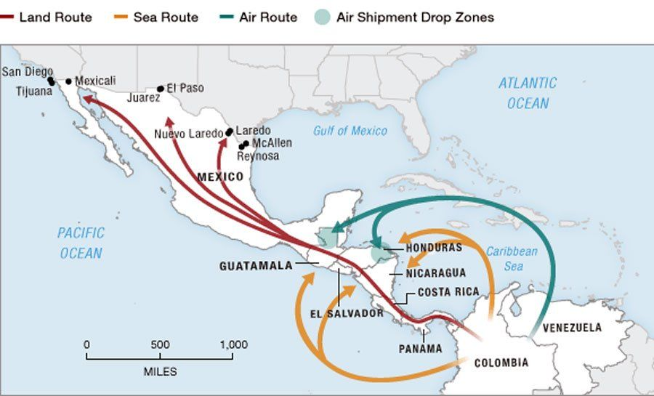
International
Narco Trafficking
(Latin America)

Slide 4
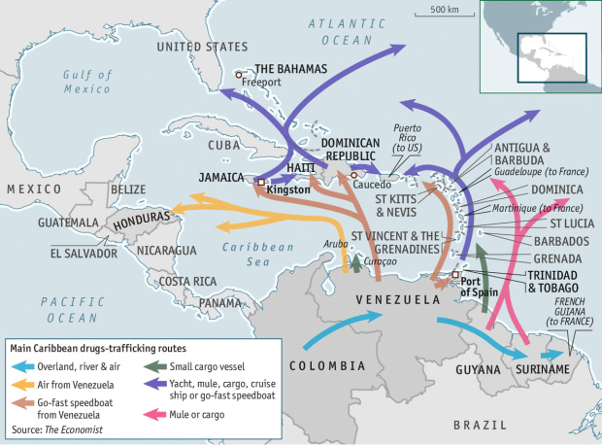
Drug Trafficking in the Caribbean

Slide 5
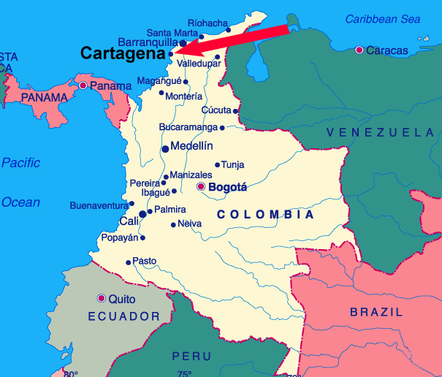
Colombia and panama

Slide 6
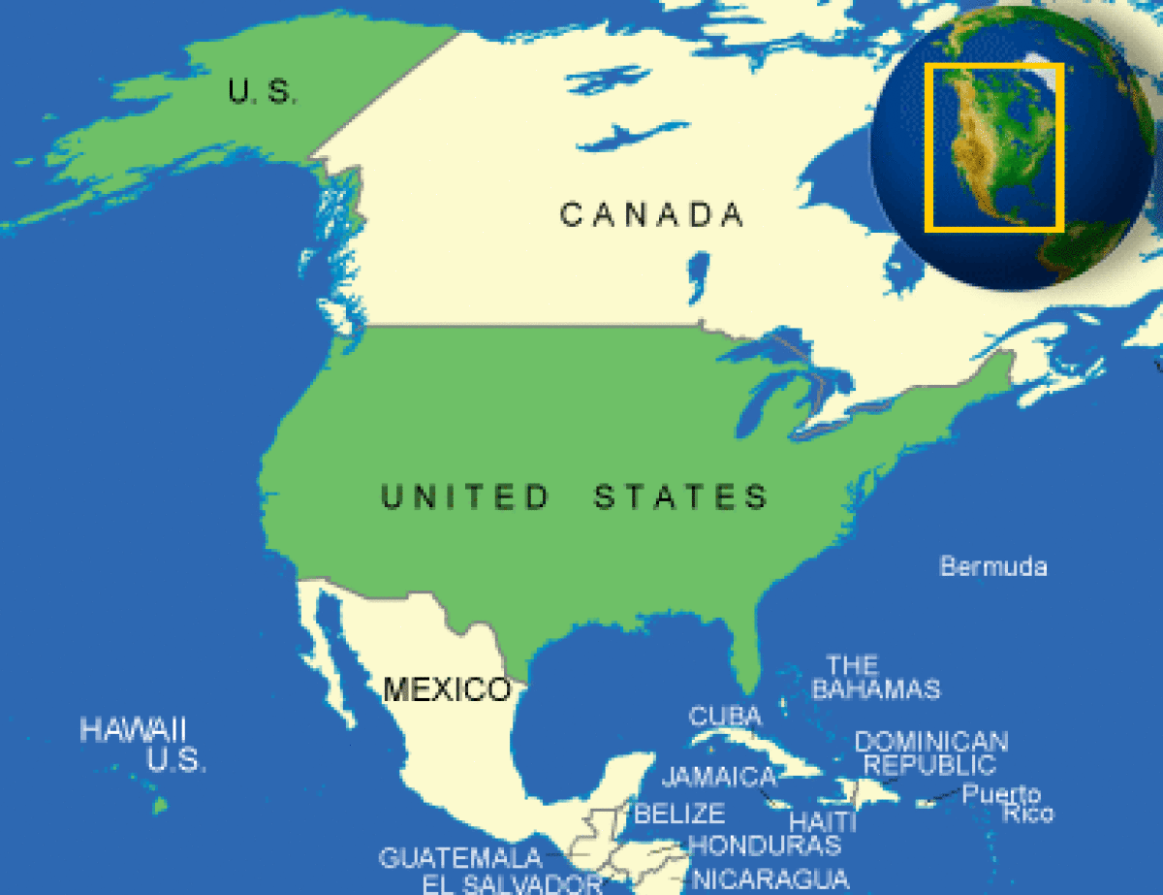
Largest consumer of cocaine*
*Source: The Center for Strategic and International Studies

Slide 7
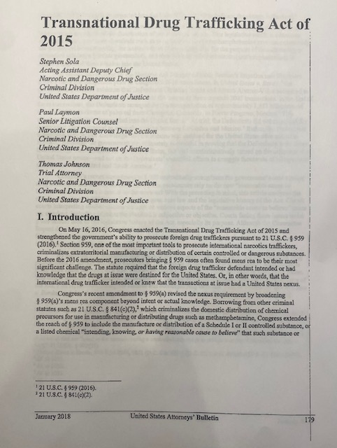
The Transnational Drug Trafficking Act of 2015, §21 U.S.C 959

Slide 8
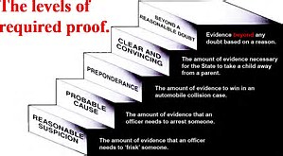
EVIDENENTIARY BURDENS OF PROOF

Slide 9
“Reason to believe” mens rea Standard

Slide 11
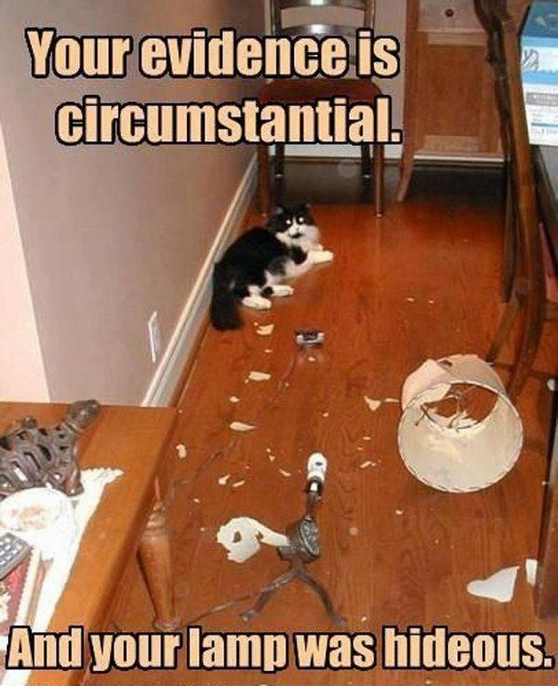
Circumstantial evidence

Slide 12
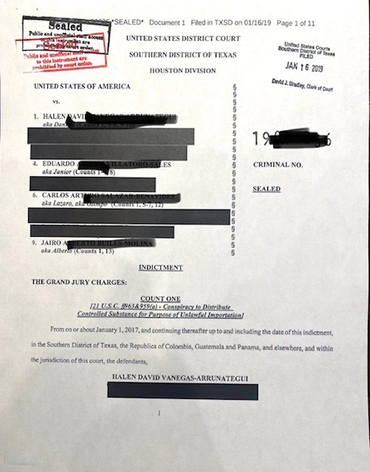
United States Federal Indictment
USA v Vanegas, SD TX
5 Count Indictment

Slide 13
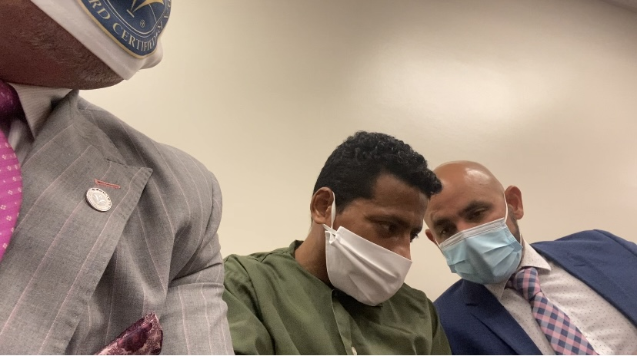

Slide 14
The typical process of how united states government get a international “target”, “fugitive”, “defendant” here
(Excluding self surrender)

Slide 15
INDICTMENT
ARREST WARRANT
AFFIDAVIT IN SUPPORT OF PROVISIONAL ARREST WARRANT
AFFIDAVIT IN SUPPORT OF EXTRADITION

Slide 16
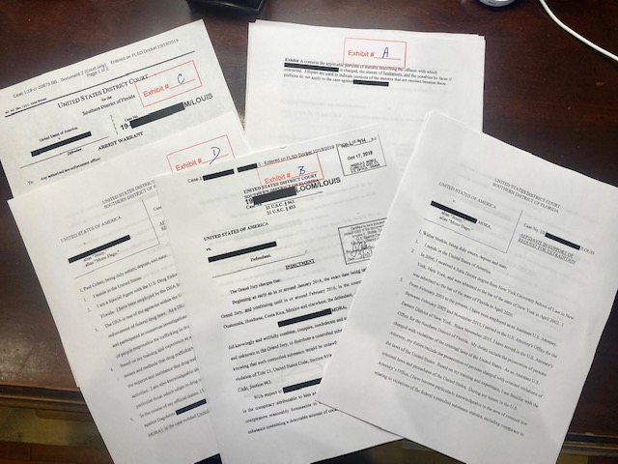

Slide 17
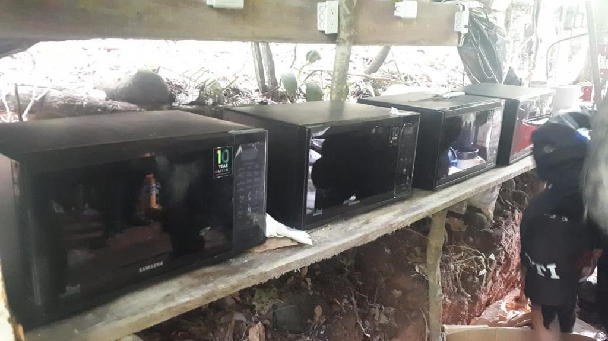
Evidence in narco trafficking case
“The kitchen”

Slide 18
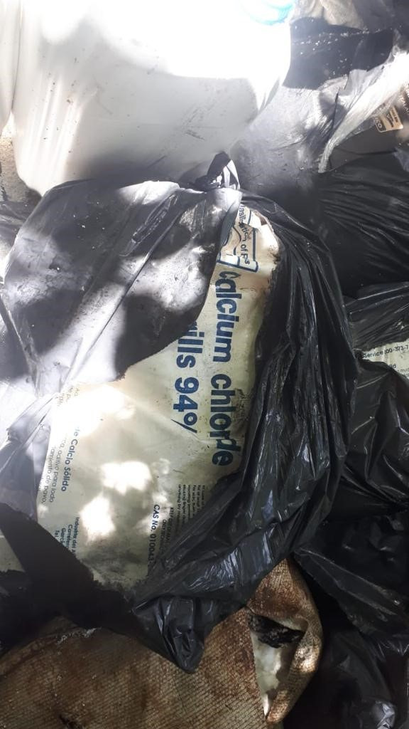

Slide 19
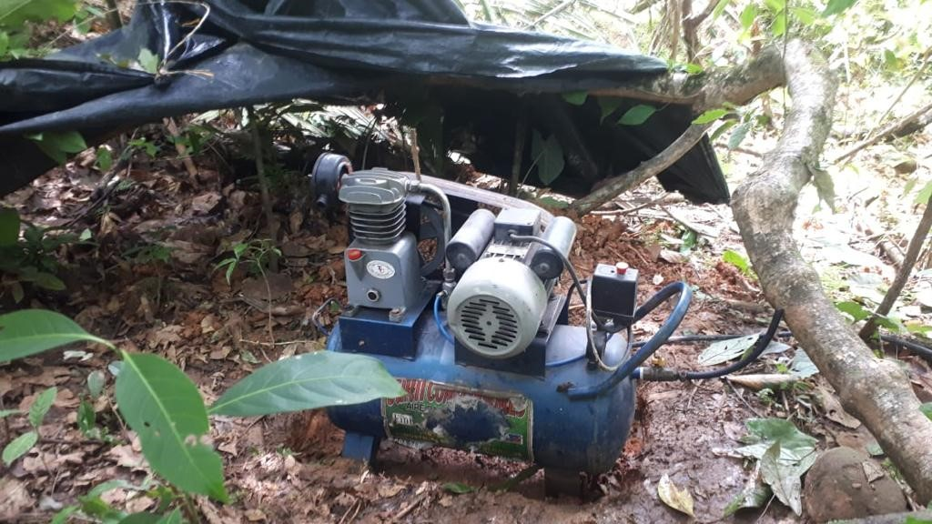

Slide 20
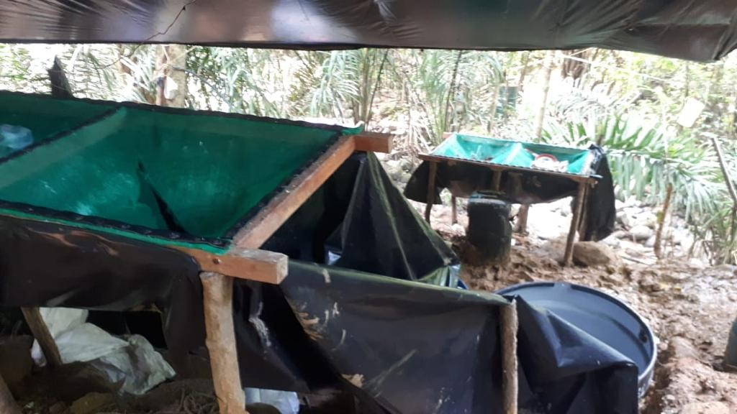

Slide 21
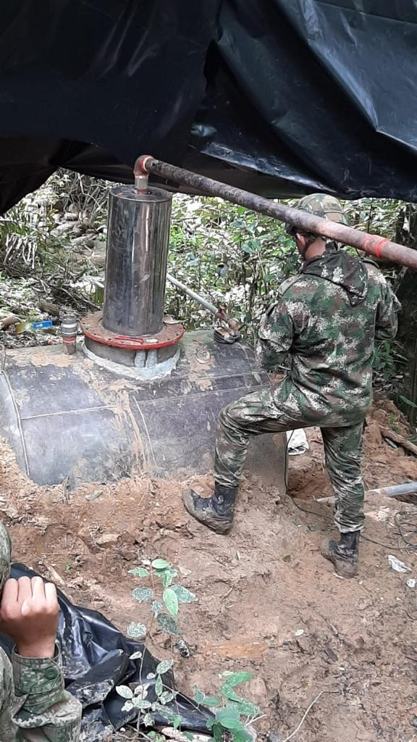

Slide 22
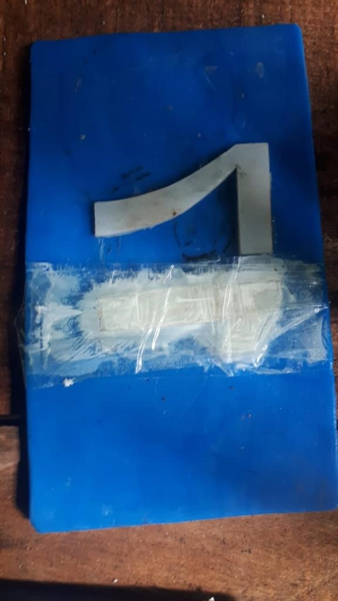

Slide 23
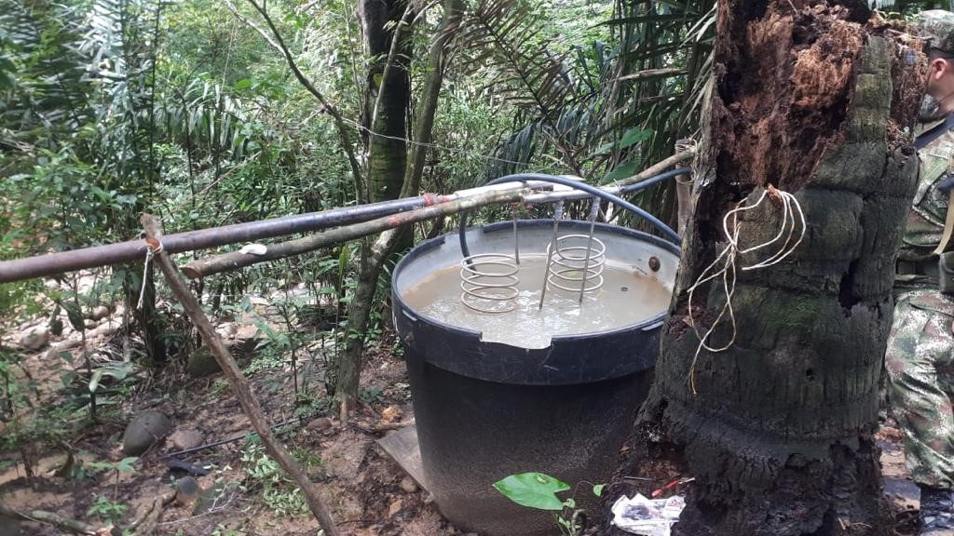

Slide 24
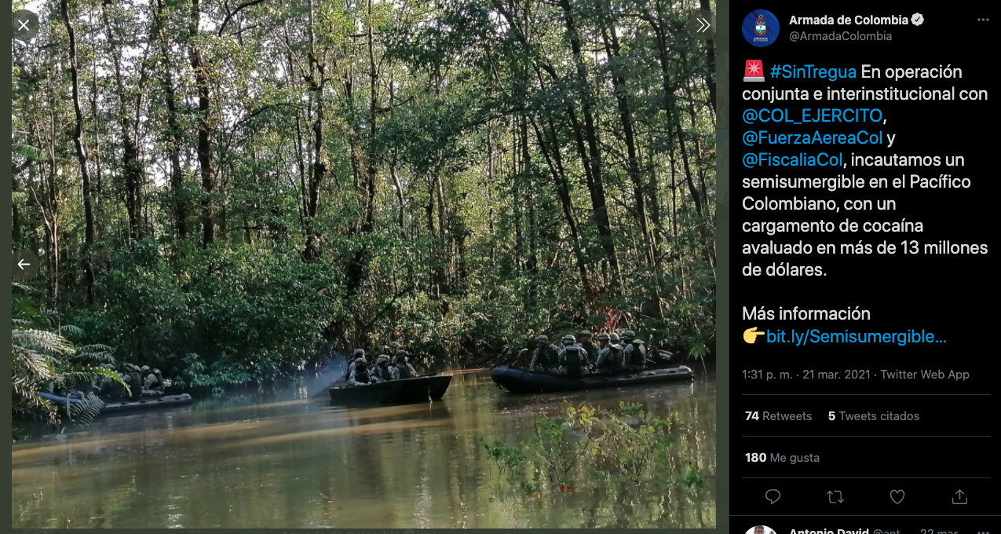
5.k1.1 cOOPERATION

Slide 25
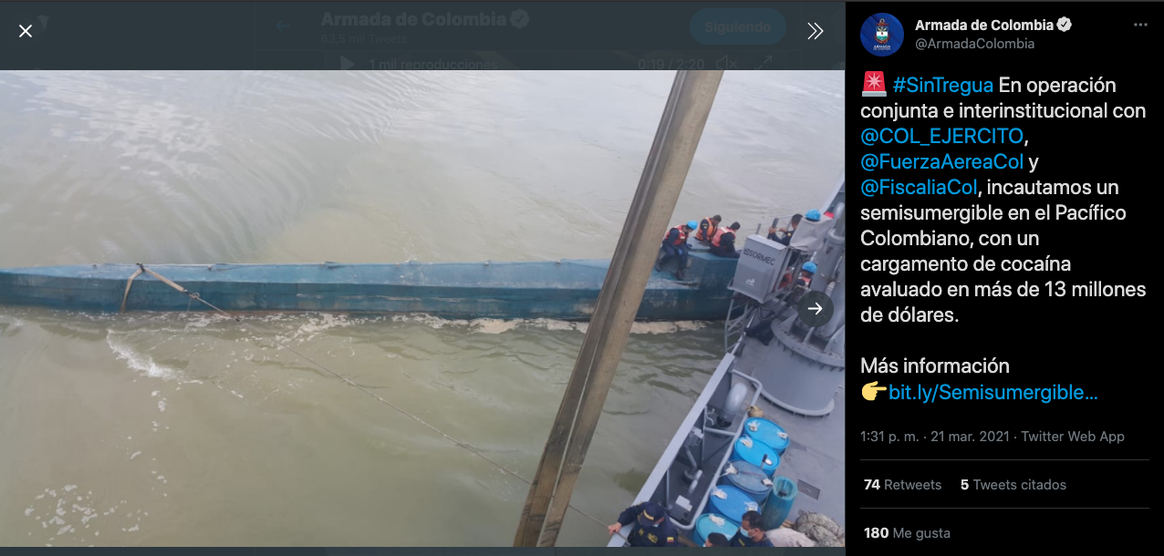

Slide 26
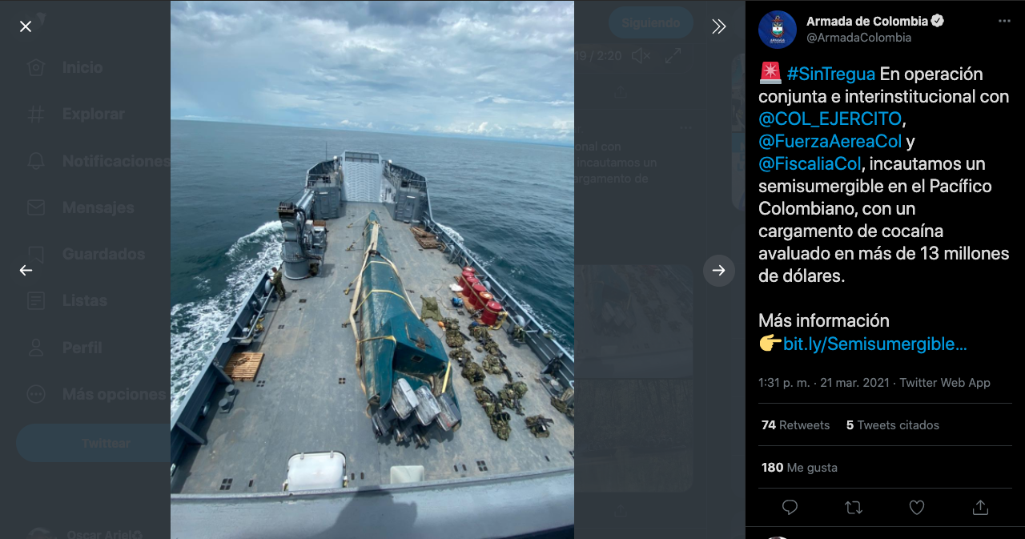

Slide 27
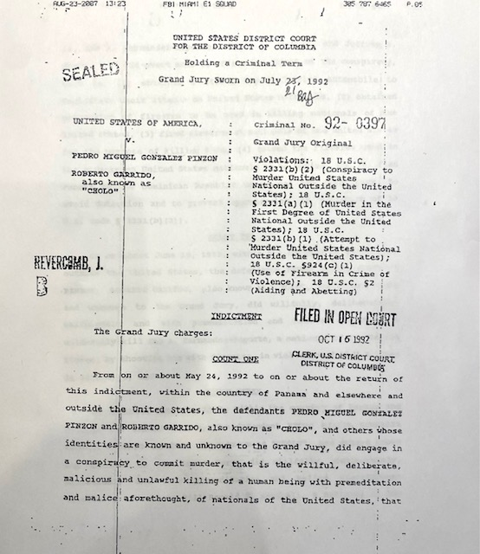
CASE STUDY-1992 usa v. PREDRO MIGUEL GONZALEZ
United States District court, d.c.

Slide 28
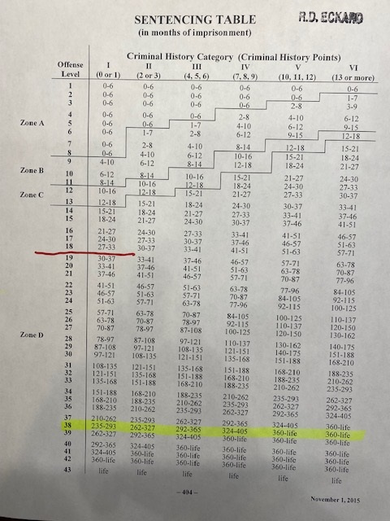
Sentencing U.S.S.C guidelines

Slide 29

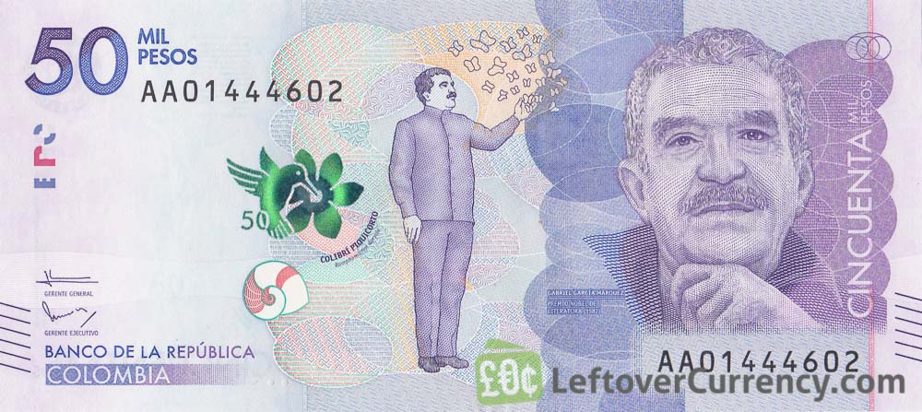
Getting paid$$$$$$$$$

Slide 30

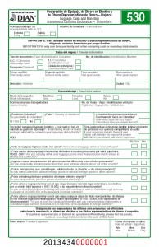
DIAN: Colombian Customs

Slide 31

United States Money Declarations

Slide 32
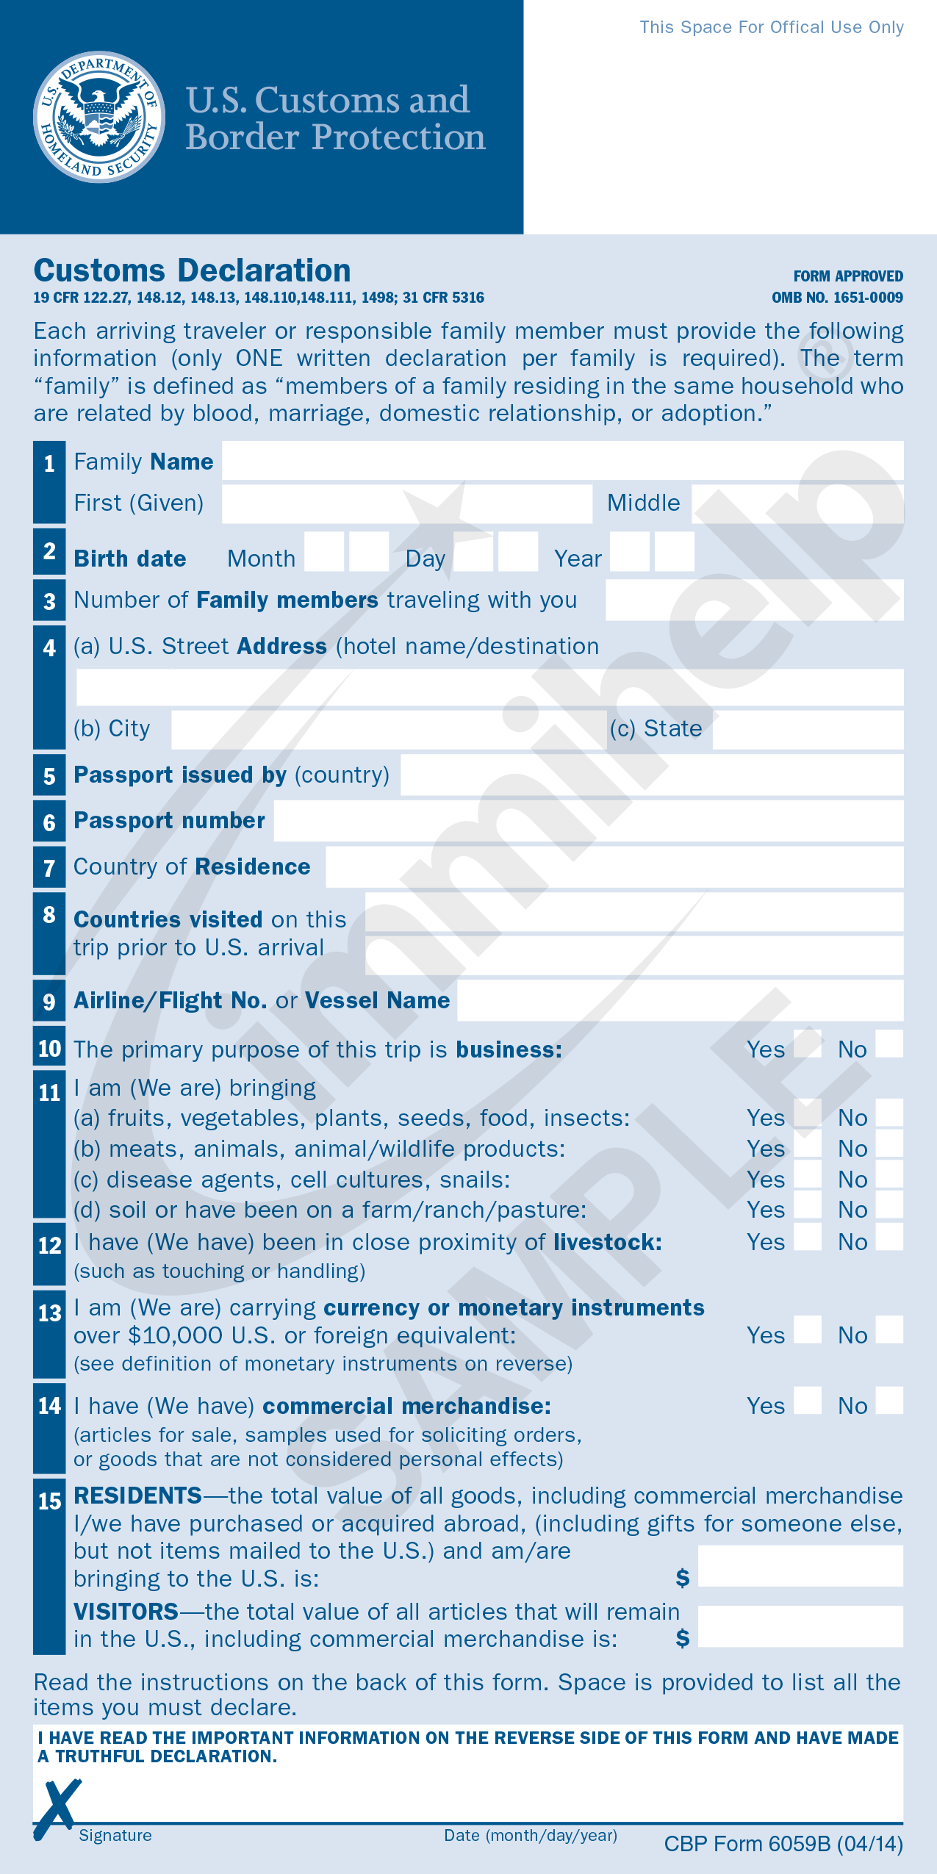
USCBP Form 6059B Declaration

Slide 33
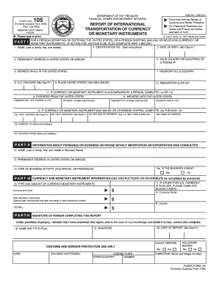
FinCen 105

Slide 34
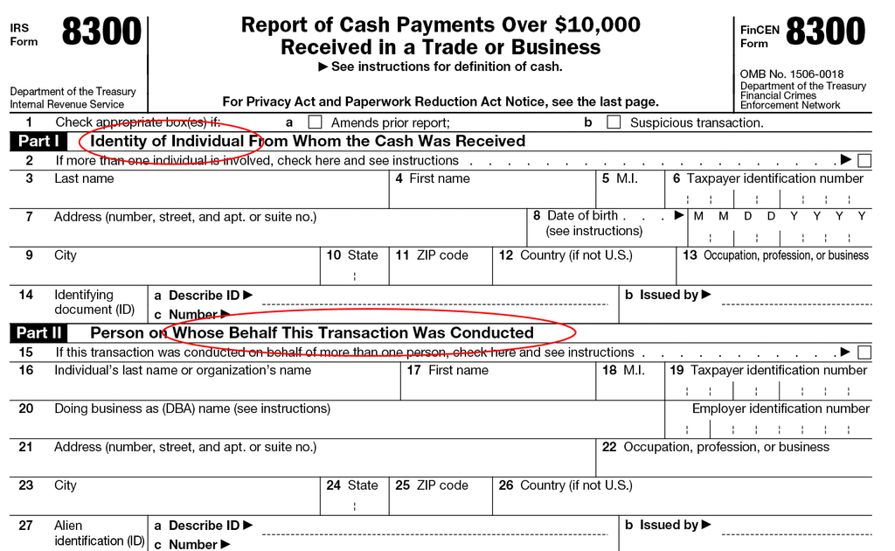
IRS 8300 Form

Slide 35
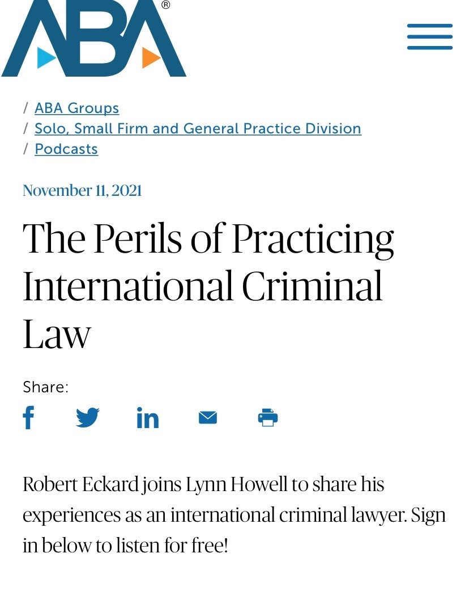

Slide 36
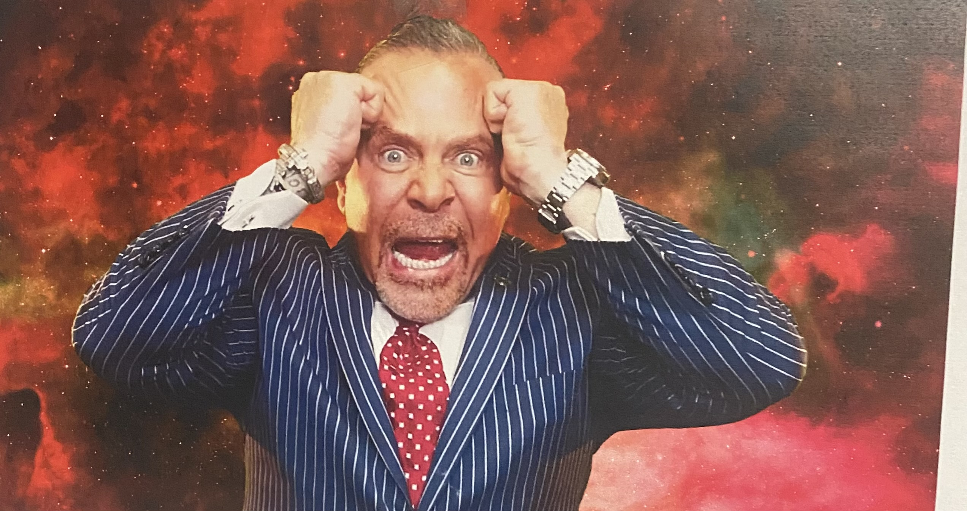

Slide 37
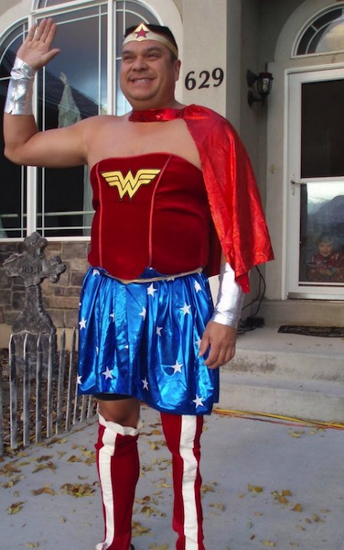

Slide 38

THE END

